Slide 1

Ch.04 Strings and Regex
Siva R Jasthi
ICS325 – Internet Application Development
Information and Computer Sciences
Metropolitan State University

Slide 2
Outline
Formatting strings
Joining and splitting strings
Comparing strings
Matching substrings
Replacing substrings
Using regular expressions

Slide 3
Why is string processing important in web development?
PHP applications, we get data from
Flat files (text files)
HTML Forms
As URL Parameters
Before accepting that data as-is, we:
Need to put it in the format we require.
Check that the data is actually valid.
We also do string processing to optimize our applications / to provide smart functionality (identifying the key words / bad words / curse words / good words, etc.)

Slide 4
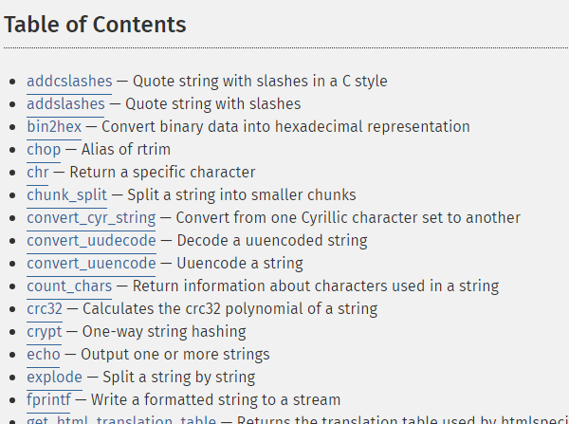
Many String functions in PHP
Over 100 string functions are provided by PHP (not including many extensions)
http://php.net/manual/en/ref.strings.php

Slide 5
String Functions
Trimming
ltrim(), rtrim() or chop()
strip whitespace from left/right of string
trim()
strip whitespace from both ends of string
Whitespace is CR, LF, \t, \0, space - but can pass in a custom list.
$name = trim($_POST['name']);
Case
strtoupper() strtolower()
returns changed case of string
ucfirst()
ucwords()
Upper case the first character of the string
the first character of each word

Slide 6
String Functions
Formatted prints
Format string using literal text, conversion specifiers and 1+ variables
printf() / fprintf() / sprintf()
vprintf() / vfprintf() / vsprintf()
print to browser, file, or string
takes variables in an array
printf("total amount is %2\$.2f (shipping is $1\$.2f)", $ship, $total);
Conversion Specifiers
%[parameter][flags] [width] [.precision] type
parameter: n$ … param can be output multiple times or in different order.
flags: [0][\d] … left pad with spaces, or zeros (%2d, %02d).
+ … always denote sign of numeric output
- … left align output of this placeholder
width: [\d] … width in output for this conversion
precision: … digits after decimal fraction. Truncates strings
type: s – string, d – decimal integer, f – decimal float
%% to echo a %sign

Slide 7
String Functions
nl2br():
replaces newlines with <br /> tags
addslashes()
stripslashes()
Escapes all quotes, backslash, NULL using "\"
Problem when inserting into database.
magic_quotes_gpc config can do this for you.
strtok()
retrieves tokens from a string based on delimiters
substr()
Extract a portion of a string
strlen()
Gets the string's length
strcmp()
strcasecmp()
compares two strings
case insensitive

Slide 8
String Functions
Searching
strstr() / strchr()
find a character/string within a longer string
strrchr()
find last occurrence of string within another
stristr()
Case insensitive version of strstr()
strpos()
Get position of a string within a longer string
Faster than strstr()
Replacing
str_replace()
search and replace operation

Slide 9
Input Sanitation
User Input is untrustworthy so screen using:
addslashes()/stripslashes()
escapes characters that might confuse a database
strip_tags()
strips any HTML/PHP tags in user input
htmlspecialchars()
converts characters to their HTML entity equivalents
escapeshellcmd()
escapes OS-specific metacharacters for use in system(), exec(), or backticks.
magic_quotes_gpc and magic_quotes_runtime
strip slashes for request variables, and databases

Slide 10
Output Filtering
Escape user supplied data
use htmlspecialchars() or htmlentities() to replace special characters

Slide 11
Input Validation
Verify
Allowed characters, lengths, ranges, patterns
Regular Expressions
Reinforce with database constraints
centralized source for all constraints
final line of defense

Slide 12
Input Validation
Verify
Allowed characters, lengths, ranges, patterns
Regular Expressions
Reinforce with database constraints
centralized source for all constraints
final line of defense

Slide 13
Useful Functions: splitting
Often we need to split data into multiple pieces based on a particular character.
Use explode().
// expand user supplied date..
$input = ‘1/12/2007’;
$bits = explode(‘/’,$input);
// array(0=>1,1=>12,2=>2007)

Slide 14
Useful functions: trimming
Removing excess whitespace..
Use trim()
// a user supplied name..
$input = ‘ Rob ’;
$name = trim($input);
// ‘Rob’

Slide 15
Useful functions: string replace
To replace all occurrences of a string in another string use str_replace()
// allow user to user a number
of date separators
$input = ’01.12-2007’;
$clean = str_replace(array(‘.’,’-’),
‘/’,$input);
// 01/12/2007

Slide 16
Useful functions: cAsE
To make a string all uppercase use strtoupper().
To make a string all uppercase use strtolower().
To make just the first letter upper case use ucfirst().
To make the first letter of each word in a string uppercase use ucwords().

Slide 17
Useful functions: html sanitise
To make a string “safe” to output as html use htmlentities()
// user entered comment
$input = ’The <a> tag & ..’;
$clean = htmlentities($input);
// ‘The &lt;a&gt; tag &amp; ..’

Slide 18
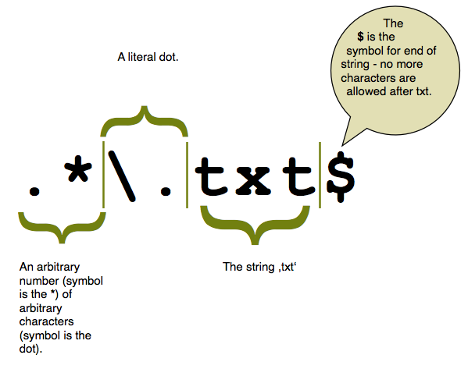
Regular Expression (regex / regexp )
Regular expressions are a concise way of pattern matching within a string.
PHP supports two flavours * PERL &
* POSIX
* PERL
When it is the time to do projects, explore regex on as-needed basis.

Slide 19
Summary
Never trust the data you read from files (supplied by others)
Never trust the data you get from the forms (input by the users)
Rely on a strong set of PHP String functions.
Employ extensions if required.
Use regular Expressions to optimize / add to your application functionality

Slide 20
References
PHP Manual http://php.net/manual/
String Functions: http://php.net/manual/en/ref.strings.php
W3 Schools - String Functions
http://www.w3schools.com/php/php_ref_string.asp
Strings and PatternMatching
http://www.ar-php.org/Resources/CPC2/05-pattern-matching.ppt

